Slide 1
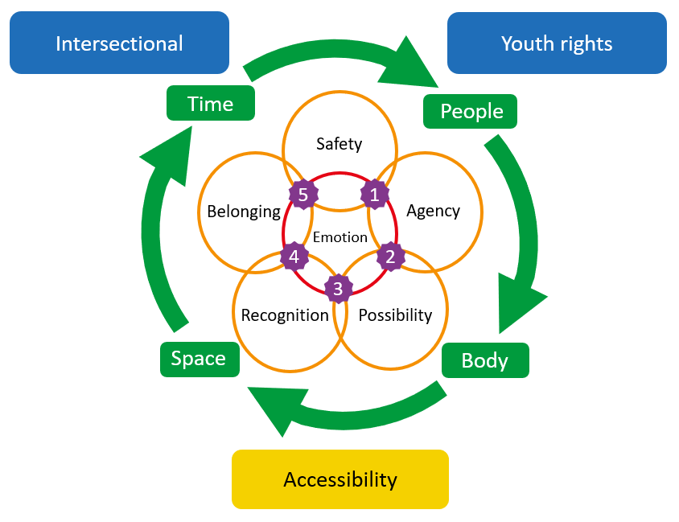
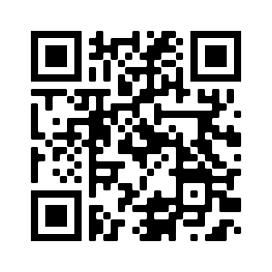
What works in mental health support for LGBTQ+ young people?

Slide 2
An intersectional youth rights approach
An intersectional approach is crucial to upholding LGBTQ+ young people’s rights. LGBTQ+ identities are often represented in ways that don’t recognise the many differences between LGBTQ+ experiences and LGBTQ+ young people’s different needs.
Doing intersectionality in mental health support requires critical reflective practice to identify how to work in anti-oppressive ways, identifying who may be privileged and excluded and how.
A youth rights approach to mental health support sees young people as rights holders independent of their parents or carers, and underlines the need for services and support providers to meet and uphold these rights.
LGBTQ+ young people have rights to non-discrimination, identity, development, autonomy, freedom of expression, safety, good mental health and good mental healthcare.

Slide 3
Structural
Regular drop-in hubs at different locations and times
Online as well as face-to-face support offers
All gender toilets
Reimburse travel expenses
‘Top-down’ anti-
oppressive working
Cultural
Co-design inclusive resources with LGBTQ+ young people
Recruit staff with diverse experiences at all levels
Display LGBTQ+ inclusivity
clearly in online and print
resources
Actively address stereotypes
Accessibility
Systems
Create easy ways to
self-refer
Provide brief explanations of confidentiality, privacy and information sharing as part of sign-up forms
Ensure that forms reflect the diversity of LGBTQ+ young people’s identities
Interpersonal
Feature diverse service
staff in online content e.g.,
videos celebrating Pride
Provide service walk-throughs online showing the service building and layout
Offer buddy systems for first time attendees

Slide 4
Key problem 1: LGBTQ+ young people have poor mental health outcomes
What’s the problem?
LGBTQ+ young people are more at risk of mental health problems (anxiety, depression, self-harm) than their cisgender and heterosexual peers
What works to reduce poor mental health for LGBTQ+ young people?
Services must support connectedness, self-expression and hope for the future as priorities to reduce poor mental health for LGBTQ+ young people

Slide 5
To address isolation and uphold Belonging
Provide LGBTQ+ groups or signpost to trusted LGBTQ+ youth groups
Connecting LGBTQ+ young people with wider communities in safe ways
Provide resources for LGBTQ+ young people to dress and present themselves in the ways they feel comfortable
Facilitate access to inclusive sports and activities (without framing exercise, weight loss or diet as ‘cures’)
To support self-expression and the Body
To address hopelessness and support Possibility
Modelling diverse LGBTQ+ lives and futures
Supporting LGBTQ+ young people’s skills and interests

Slide 6
Key problem 2: LGBTQ+ young people underutilise mental health services
What’s the problem?
LGBTQ+ young people are reluctant to seek support due to fears of discrimination, of LGBTQ+ identity being treated as a cause of mental health problems, and being ‘outed’
LGBTQ+ young people are more likely to use mental health support when they can see that the service is safe, knowledgeable and affirming, and when support fits into their lives
What works to increase LGBTQ+ young people’s use of mental health services?

Slide 7
To provide a Safer service
Transparent policy around confidentiality and safeguarding, communicated in young person friendly ways
Seek regular feedback from LGBTQ+ young people on the service’s safety
Service providers have a demonstrable track record of working with and understanding LGBTQ+ young people
Ensure facilities are accessible and inclusive e.g., providing all gender toilets
To ensure that young people feel recognised, respected and affirmed
To ensure that the service fits into LGBTQ+ young people’s lives
Provide rapid response to initial contact
Seek feedback from LGBTQ+ young people on support frequency, pace, timing and duration

Slide 8
Key problem 3: LGBTQ+ young people have poor experiences of mental health services
What’s the problem?
LGBTQ+ young people’s poor experiences of mental health include: limited staff understanding of LGBTQ+ identities; having their LGBTQ+ identities dismissed, undermined or treated as problems; and being excluded from decisions about their care
LGBTQ+ young people have better experiences of using mental health support when they feel ownership of the support space and can trust the people providing support; services must also support informed independent decision making and centre emotions
What works to improve LGBTQ+ young people’s experiences when using mental health services?

Slide 9
To create Spaces that centre LGBTQ+ young people
Co-design service buildings and spaces with LGBTQ+ young people
Ensure that spaces are comfortable and welcoming
Advocacy support can help LGBTQ+ young people to navigate important relationships in their lives
To foster trusting relationships
To develop agency and informed independent decision making
Provide options-based support that upholds LGBTQ+ young people’s rights to be heard and to autonomy
Policy and specifications ensure LGBTQ+ young people’s involvement in decisions about their support
Centre emotional language and education in service materials and approach e.g., sadness, panic, fear, anger, hopelessness
To centre asset-based emotional support

